Slide 1
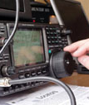
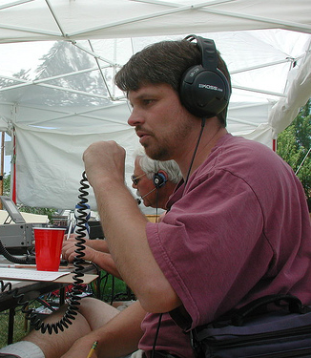
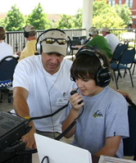
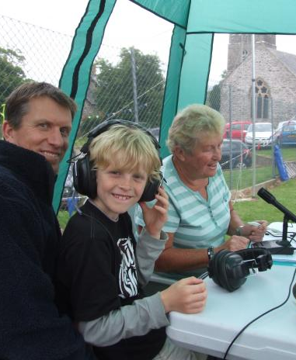
UKSPF – Amateur Radio
Graham Murchie – G4FSG
Murray Niman – G6JYB
Notes:
Graham Murchie – Chairman of the RSGB Board
Murray Niman – Chairman of the RSGB Spectrum Forum

Slide 2
What is the RSGB?
UK’s national amateur radio (AR) society
Founded in 1913; Patron is HRH The Prince Philip, Duke of Edinburgh
Dedicated to the development of science and practice of amateur radio
Represents the interests of UK’s 60,000 licensed radio amateurs nationally and internationally
Conducts examinations
Network of 500+ affiliated clubs across UK
Notes:
RSGB (www.rsgb.org) is the UK’s national AR society and currently has over 21,000 Members
As you can see it has existed for over 100 years
Members are encouraged to take an active role in the Society, and over 1,000 give their time to help provide support and guidance across the range of amateur radio activities
Represents all amateurs to the UK government through Ofcom and to the international organisations that govern the hobby
Manages Exams at Foundation, Intermediate and Full level – a licence requirement for any enthusiast who wants to get on the air
Publishes monthly magazine, RadCom and two electronic supplements RadCom Plus and RadCom Basics.
Produces an extensive range of books
Operates as a limited company with a break even objective
Through the website, weekly news broadcast, GB2RS, and social media, the Society provides up-to-date news and information to radio amateurs
Holds an annual convention that includes internationally-recognised experts

Slide 3
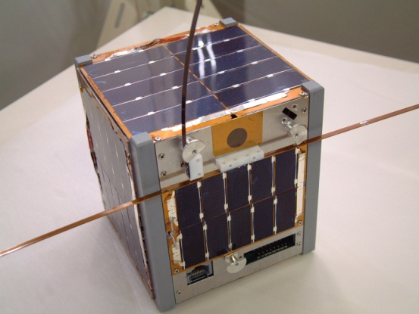
Scope of the sector
Defined by ITU RR Articles 1.56, 1.57 and 25
Amateur service
Amateur-satellite service
136kHz – 248GHz (and more!)
Approx 70k UK licences
Approx 3.5 million amateurs worldwide
Notes:
As with all other services, the amateur service is defined by the appropriate ITU Articles.
We must not forget that there are two services – amateur and amateur-satellite
Frequencies in common use around the world used by amateurs extend from 136kHz to 248GHz with extensions likely to both lower and higher bands. Operation at 9kHz and 275GHz has been tried around the world.
There are in excess of 70k licences issued by Ofcom but we (and Ofcom) believe that there are roughly 60k individuals who are licensed as several people hold more than one licence, whether it be for different skill levels, for clubs or for repeaters and beacons.
Globally the current estimate is that there are 3.5M licensees around the world. Numbers are overall fairly constant with some countries increasing in number and others decreasing. China, India and USA are increasing but Japan has reduced over the last 20 years. Interestingly this seems to reflect the change from a world leader in manufacturing to their economy slowing down. I’m not sure which came first the licences reducing or the economy slowing. The UK shows an increase over the last ten years.

Slide 4
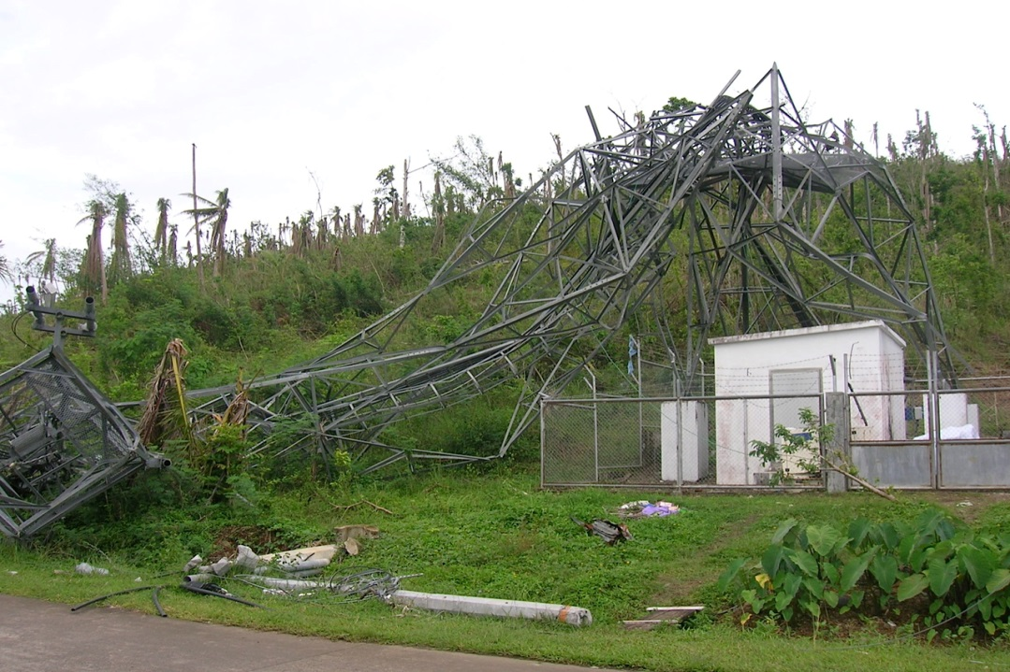
Social and economic value
“Amateur” means “unpaid”
High tech skill base
Technical innovation
STEM
Emergency backup
Crosses international boundaries
Notes:
ITU Handbook on Emergency Communications has a section headed Amateurs as Professionals . To quote ‘In situations where a professional and helpful attitude is maintained, served agencies point with pride to Amateur Radio volunteer efforts and accomplishments. Although the name says “Amateurs,” its real reference is to the fact that they are not paid for their efforts. It need not imply that their efforts or demeanor will be anything less than professional.’
A recent quote from Kristalina Georgieva, EU Commisioner – ‘Amateurs’ is actually not the right word in this case; these are professional communicators.
ITU Art25 states Transmissions between amateur stations of different countries shall be limited to communications incidental to the purposes of the amateur service, as defined in Art. 1.56 and to remarks of a personal character.
In fact the UK licence specifically states ‘……..the Radio Equipment is only used…. as a leisure activity and not for commercial purposes of any kind’ so it is quite difficult to define the tangible economic value of AR.
We therefore need to look at the intangible benefits.
Amateurs are required to take examinations to be licensed. At least one of the levels requires practical skills to be demonstrated. Many amateurs are extremely skilled in a practical sense across a broad spectrum – rf design, construction, antenna design and construction, mechanical design and construction, System configuration etc.
Technical innovation matches the professionals in the sector. Joe Taylor, an American amateur, who has a Nobel Prize for Physics and Prof at Princeton University continues to develop his weak signal digital techniques that is allowing relatively modest stations to use EME, MS and Tropo Scatter to make contacts all over the world on the VHF, UHF and microwave bands. Equally, Howard Long, a British Amateur, has designed and sold many thousands of his Funcube Dongle which is used by amateurs, universities and schools to receive, at low cost, both satellite and other signals.
Virtually all sectors of society in the UK recognise that the focus on STEM topics is not producing the required number of practical engineers to maintain UK plc. Amateurs are able to exhibit many of the skills and the RSGB has a number of initiatives to try and bring practical skills to school groups and others. It is important to emphasise STEM, the need for which is probably stronger in 2015 than a few decades ago because of the greater significance of embedded software (and hence maths) and system engineering as the actual radios have been commoditised or morphed into SDRs.
Following the 1953 East Coast floods when licensed amateurs were the only radio stations able to communicate with ships in distress off the east coast licensing conditions were changed to allow amateurs to assist at times of national emergency. The Lockerbie disaster is a prime example of where assistance was given with the local Raynet group being on 24 hour duty for ten continuous days. Relatively speaking, the UK has few natural disasters on a large scale so such emergency support is not often needed but this is not the case in many other areas of the world. In the USA the FEMA head is a licensed amateur and amateurs have assisted in many recent events including Haiti and the New Orleans floods. It is interesting to note the move in the USA for emergency usage being more directed at contingency/peace of mind against infrastructure failure rather than the traditional role of disaster response.
The November 2013 Typhoon Haiyan in the Philippines completely destroyed the communications infrastructure on some islands and only radio amateurs were able to communicate with the outside world. Mobile phone systems have battery back up but that is not a lot of use when the tower is completely destroyed!
The Nepal earthquake is another good example of recent international cooperation and system's usage.
The fact that radio crosses international boundaries is almost a given – you try and stop it!

Slide 5
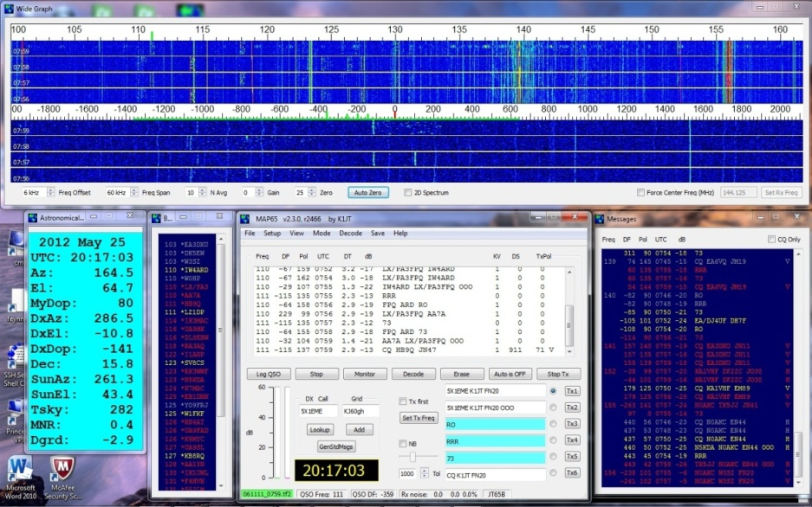
Sector trends
Despite the www, radio (wireless) vital
Computing/radio integration
SDR technology
Weak signal activity
Satellites
Notes:
When I first started my professional career as a Microwave RF engineer I was asked why I had gone into radio ‘as there was no future in it!’ 45 years later and radio has again become ‘wireless’ and, in the UK, we are short of skilled RF engineers. Being in radio didn’t stop me from understanding the internet as towards the end of my career I ran the IP network in the UK. The two cannot live without each other and everyone constantly uses wireless devices every day, many without realising it!
Computing and radio will continue to converge and be complementary. We cannot exist without either these days and there are many radio amateurs either present or previous licence holders who are contributing to this trend. Amateurs are using digital voice with data and have extensive networks linked through the internet. Also there is an amateur radio designed codec for voice.
SDR is almost the norm now with both RX and TX being SW defined these days.
I have already mentioned Joe Taylor’s activities in producing the software to allow weak signals to be recovered from below the noise and this continues to be developed for EME, MS, AS and many other modes. The picture represents a typical screen.
I mentioned earlier that as well as the amateur service, there is also the amateur satellite service. In the last 40 years over 40 ‘traditional’ amateur satellites have been launched and the numbers are increasing as micro or cubesats are launched. These are typically 10cm cube and some 100 of these cubesats have been launched or are imminent. The UK are involved in design of a number of these but it is telling that the team cannot find the appropriate RF skills in this country so are having to use engineers from the USA, Holland and Denmark! The majority of satellites have been in low orbit and therefore burn up in due course. There are two projects scheduled to come to fruition in the next 2 years or so that will put the first amateur geosync satellites up. Having been negative about UK RF engineers, there is a real success story in the form of SSTL which is a company spun out from the work of a group of amateurs at the Univ of Surrey and over the last 30 years has turned into a £125m per year company employing some 600 staff. Last, but by no means least, indicative of the dramatic increase in activity, in the next 3 weeks the Chinese will be launching no less than 10 small amateur satellites in one go! Some launchers have carried in excess of 30 cubesats at a time. Many of these cubesats (especially from universities) have their frequencies coordinated by IARU (International Amateur Radio Union) on behalf of the ITU Bureau. This unprecedented growth in smalls-sats has also led to WRC-15 AI-9.1.8

Slide 6
Sector threats
EMC – EU regulation and monitoring weak
Domestic equipment
xDSL
PV and wind
Wireless power transfer
Loss of Microwave bands
Notes:
There are many EMC regulations and standards but monitoring and policing them can, to say the least, leave a lot to be desired! We all know about CE testing and marking where a number of companies out side the EU have a habit of ‘forgetting’ to populate all the suppression components once compliance has been approved. There are also issues about standards being less firm at frequencies above 30MHz.
As amateurs are often involved in weak signal activity then interference from all sources is a continuous challenge. Plasma TVs, for example, were a real challenge but LED televisions are much cleaner. LED lights, on the other hand, can still cause significant problems (and not only to radio amateurs)
VDSL operates up to 17MHz and can cause significant interference on some of the lower amateur bands. Relatively recently the service providers have moved to self install where the customer receives the relevant equipment though the post – we have noticed a definite worsening of the situation since this started as unbalanced lines and in house wiring become ‘excellent’ antennas. The next generation of UFBB will operate at frequencies up to 106MHz and the RSGB are working with BT to run tests ahead of the first installations.
PV installations are generally OK except when not installed correctly and can cause significant local problems.
Land based wind generators can cause immense problems and certain designs about 80m high and built on fenland or wet areas have been measured as increasing the noise floor by up to 50dB within a 5 mile radius. The fact that 80m is a half wavelength on one of the amateur bands may have something to do with this!
Wireless Power Transfer is currently being tested in real urban situations, but has yet to take off. We suspect that we will have some major issues.
A more specific threat of concern is the reduction in the availability of certain microwave bands. Murray will be covering this a little later.

Slide 7
Use of technologies and spectrum
AR spectrum allocation agreed globally within ITU
Need blocks which are relatively noise free for weak-signal long distance operation
Some ‘Primary’ status, but not enough
Satellite communications – Voice and TV
EME and other very weak signal operation
Digital ATV
Notes:
Spectrum for amateurs is, like all other services, allocated within the ITU. Of course, amateurs don’t necessarily know to whom or which country they will speak to when they go on the air so it is important to understand, not only the allocations but the usage within those allocations of spectrum. We are pleased to say in the UK we have a good working relationship with Ofcom – it is not so with the local regulator in all other countries!
As much of our communication is by weak signals then it is important that we have relatively noise free and preferably Primary status bands where possible. Over the last few years the HF and low VHF bands are becoming somewhat less congested and the higher frequencies are the opposite. Not only are there other radio services causing challenges but, of course, also interference from computers and networks. The weak signal (usually narrowband) modes reach considerable distances (>2000km at 1.3GHz and still up to >100km at 76 GHz).
The satellite service is in a similar position as they have no primary allocation between 144MHz and 24GHz.
I have alluded to EME and other very weak signal operation before – interestingly it is becoming possible to operate with a 100W transceiver at VHF plus an 8 or 10 element yagi and make a successful 2 way contact via the moon (but not if the stations at both ends are similarly equipped but this is getting closer all the time as the software improves).
A recent presentation to the Business Radio Industry Group on how amateurs have developed low BW digital TV was well received and a number of follow up requests have been received.
On a slightly related topic of TV, the ISS will be using Ham TV to link to schools and when Tim Peake goes to the ISS later this year he will be using AR to contact schools in the UK. This has been done previously but this time the astronaut will be a licensed British amateur and we know that he is looking forward to this aspect of his mission to involve schools directly.

Slide 8
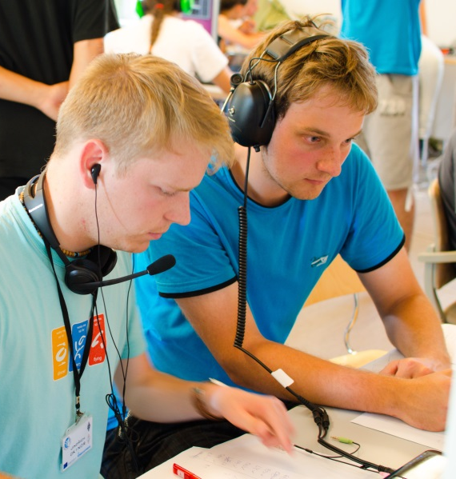
Expected changes
Digital modes (Voice and TV)
Not exclusively digital
Further embedded software and equipment system convergence
Lowering the age profile
Remote control, automation, apps, bridging between modes, further ISS/satellite growth
Notes:
There will be increasing migration to digital modes but not exclusively so. I have to say that there is still a significant use of morse code which is a very efficient mode particularly without any computer interfacing. Interestingly whenever we run demonstration stations there is a great interest from the younger generation in simple morse code – it is, of course, a ‘digital’ mode but doesn’t require a computer to be used.
How will sw and radio further integrate – who can really predict but I am certain that it will! I recently read an article that suggested that radio receivers were on the ninth generation. The first generation was 1901 (or thereabouts) and the last three generations have been in the last 15 years and all software based.
As the older generation of amateurs become less active then the younger ones will bring about a redefinition of what is core to AR. The Society has formed a YC in the last year and we are seeing initiatives and enthusiasm that some of us can remember from long ago. There is little doubt in my mind that enthusiasm for this particular service will continue to grow.
The final bullet lists a number of areas that we think will be key as we move forward.
Hand over to Murray.

Slide 9
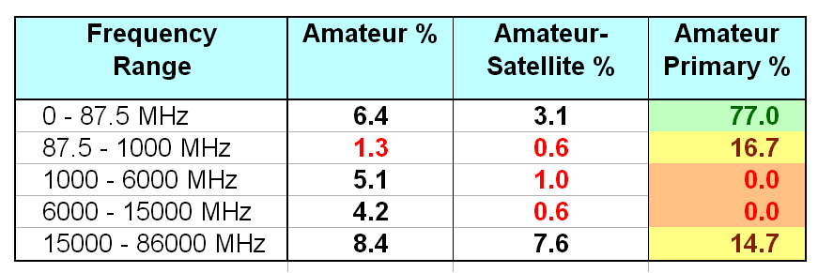
Spectrum Status
UK amateurs have access to 136kHz - 248GHz
Lack of Primary spectrum hinders both Amateurs and ultimately the wider UK
Global harmonisation is a priority due for long distance narrowband EME and satellite usage
Notes:
The UK Amateur allocations are tabulated in the Ofcom Amateur Radio Licence for each licence class. The latest edition is at:-
http://licensing.ofcom.org.uk/binaries/spectrum/amateur-radio/guidance-for-licensees/nov/licence.pdf
PSSR saw amateurs lose 40 MHz at 2.3GHz and 65 MHz at 3.4 GHz, with the largest impact on wide band datalink and TV users.
One small mitigation is that Ofcom have granted some access to the 2MHz at 2300-2302 which was unused after an old auction
The table in the slide is a spreadsheet output derived from the allocations (and their widths/status) using the latest (Post-PSSR) Ofcom 2015 UK Amateur licence. The frequency ranges are as per Ofcoms Spectrum Management Strategy doc ‘ Spectrum attribution metrics’ , Dec-2013 (which gave an overall average of 3% to Amateurs and 1% for Amateur Satellite)
According to IARU, the average in other regions is that ~8% of spectrum is available to amateurs with up to half on a Primary basis
There is no Primary allocation between 400MHz and 24 GHz. The lack of even small primary segments in this wide range gives rise to considerable restrictions and uncertainty that threaten investment/growth as well as the development of future practical rf/microwave engineers.
Whilst short range wideband kit can adapt /retune more easily, Satellite transponders EME and narrowband terrestrial user cannot. For the latter a key spectrum goal is that ‘common narrowband segments’ become globally harmonised and better protected
9

Slide 10
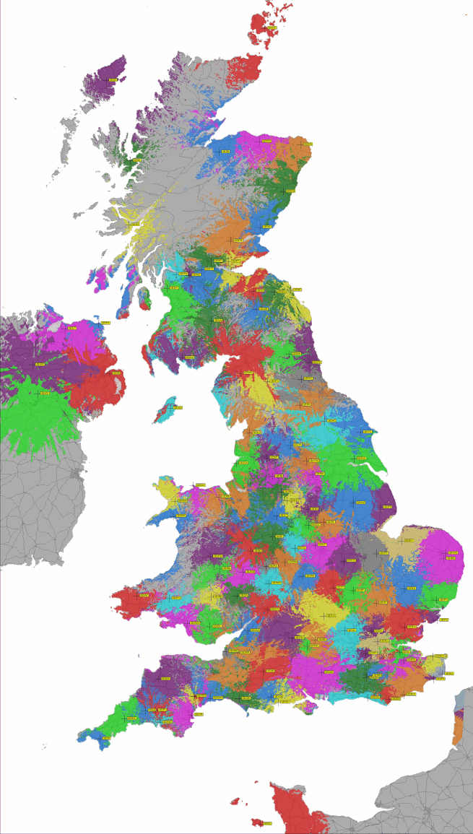
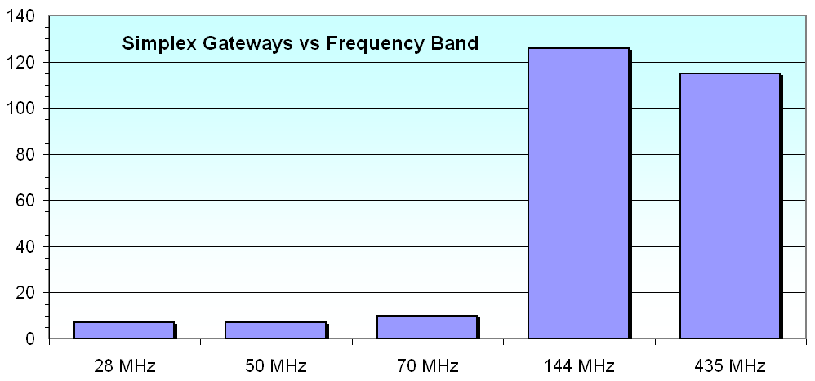
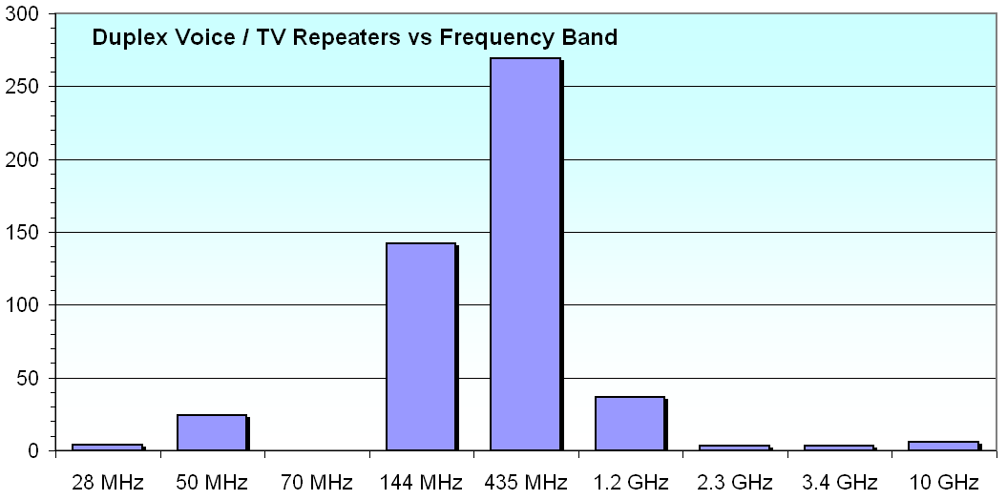
Infrastructure
Demand highest at VHF/UHF
1000 managed systems
Digital/network use growing
Propagation beacons to >47GHz
Notes:
RSGB coordinates almost 1000 items of infrastructure (which Ofcom assigns specific callsigns and licences to) inc 265 simplex gateways, 480 duplex voice/tv repeaters , 100 beacons, hundreds of data/mailbox links etc.
Repeaters often on high shared sites to achieve maximum coverage. The map is just for 144 MHz duplex repeaters
Extensive online system for handling applications/changes mapping and propagation prediction
The narrow amateur allocations in turn mean that the Duplexing filters are built for far narrower splits and higher performance than is typical for commercial PMR
Most Analogue FM systems have been rechannelised to narrow bandwidth, CTCSS access, and many are Echolink/IRLP internet linked
Strong growth is occurring for Digital Voice systems including D-Star, DMR and Fusion modes.
The digital systems lend themselves to more sophisticated/automated routing
Many radios/systems also include position/weather reporting data
The networks are internationally linked for global roaming/routing - and are all free at point of use!
Links also include pooling / reflectors for conferencing
One example is that many DMR systems are part of the worlds largest Mototrbo network
100 propagation beacons (mainly in microwave bands) have an automated report database. (as well as individual users who use WSPR to achieve similar reports)
Increasingly it is only amateurs who will have deep propagation knowledge not industry/academia
Each beacon, repeater or gateway has 3-4 closedown operators listed with Ofcom in addition to the keeper – so overall the financial and manpower commitment across the entire networks are considerable
In addition to all the above, in each county many RAYNET emergency groups have their own mobile or fast-deployment repeaters (outside the 1000 fixed ones)
10

Slide 11
Spectrum sharing
Amateurs self-manage a wider diversity of modes
We practice LBT, DFS, geo-aware etc - always!
Excellent sharing record with PMSE, Radiolocation, Military.
Studies cover up to 79 GHz
Difficult to share with mobile broadband and ISM in secondary allocations
Notes:
Compared to say Broadcasting or Mobile where there is uniform stds/channelling, each amateur band has a very wide diversity of equipment, modes and usage
Amateur Radio spectrum managers thus pay great attention to band planning to address spectrum efficiency/interoperability by grouping modes by either bandwidth, global weak signal/satellite usage etc (as compared to the top level Ofcom amateur licence which is technology neutral)
Bandplans are reviewed nationally each year and internationally coordinated every 18mths/3yrs
This experience benefits us when needing to share with Primary Users as well as other amateurs.
Some Secondary HF bands are made contest-free to avoid excessive traffic upsetting Primary users
Listening Before Transmitting, Frequency selection to find a free channel etc have all been practiced for many years (helped by the human brain in the loop). Digital systems can automate this – but we are aware that if the modes are different you may not recognise the other party - so the bandplans try to cover this contention/conflict issue (an interoperability issue)
Sharing studies have included 5GHz wireless industrial automation (WIA) and 77 GHz Cars/Helicopters
In the UK special considerations have enabled us to share in for example 5 MHz, 435 MHz , 1.2GHz (and the retained part of 2.3GHz) where the Primary users can be very sensitive

Slide 12
Spectrum trends
Ongoing use/congestion highest at HF
Infrastructure demand at VHF/UHF
Beacons , EME etc popular in microwave bands
Data links/mesh growing in microwaves
Distance records at microwave/millimetre wave
More TV in lower bands. More use in 76, 134 GHz
Smart radios – flexible Apps, bridging, codecs
Growth/exploitation of small satellites, airborne
Notes:
As HF is international and busy (esp at weekends/contests), there continues to be demand for HF expansion, possible assisted in longer term by decline of MW/SW broadcasting
Digital Voice Innovation has caused a surge in infrastructure applications. This may eventually be mitigated by multimode software radios and more adaptable codecs but some expansion necessary
UK has a low base for higher speed / adhoc data networks (5GHz Hamnet etc) compared to Europe. So would expect growth from such a low base
UK is a lead in small satellites and close links with the high orbit / ISS groups
Most recent spectrum requests have been at 1.8, 5, 50, 71, and 3400 MHz.
RSGB is a regular participant on the UK Ofcom delegation to CEPT/WRC to progress spectrum matters
Back to Graham for the final slide.

Slide 13
Longer term
Protect amateurs’ freedom to innovate’
Opportunist communications mode
Even further networking/wireless integration
Scarcer skills need encouraging
Even higher frequencies
Notes:
Amateurs must (and will) strongly resist any move to take away the unique right to design, build and operate equipment and systems without any external controls once the appropriate exams have been passed and licence issued.
There are many different facets of AR whether it be local cross town FM contacts, wider contacts on the LF and HF bands, enthusiasts who spend up to half a million dollars activating a remote uninhabited island, bouncing signals off the moon or any other interest, the vast majority of the time, the use of the frequencies is ‘opportunistic’. Predicting what will happen is as much an art as a science that continues to challenge us all. One mode that affects the higher HF and lower VHF bands is ‘Sporadic E’ – anomalies in the E layer of the atmosphere that a number of very clever professionals and amateurs have been trying to explain for some years now but their various theories continue to be confounded.
I said earlier and I repeat ‘How will sw and radio further integrate – I don’t know but it certainly will!’ The likes of Bluetooth and NFC will increase in use and they are all dependent on radio.
We need to promote the scarcer skills and we are concerned that schools are not encouraged to engage in the practical skills related to STEM. The RSGB are meeting with the IET in the next week or so to exchange ideas to see if, between us, we can do more about this.
In 2012 Ofcom asked for additional assistance to help with managing the spectrum during the Olympics. I think that those Ofcom people present today would support the view that the breadth of skills demonstrated by the RAs who volunteered and assisted was significant. These broad practical skills are not taught at school or university but are gained by ‘learning on the job’.
One hundred years ago when the predecessor of the RSGB was formed, amateurs were given the short wave bands as they were thought to not be useful by ‘the powers that be’. That proved not to be the case as we all know. Similarly we are discussing frequencies above 275GHz with Ofcom at the moment and whilst there is some usage at present we believe that amateurs will, yet again, prove how useful those frequencies are. (Indeed the entire ‘Cloud’ may be built with them in future as copper/fibre is replaced with xxGb/s wireless interconnect)

